Slide 1
Visual Programming
Week 2
Lecture 2

Slide 2
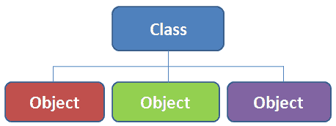
Introduction to Classes and Objects in C#
A class is a blueprint for creating objects. It defines properties (variables) and behaviors (methods) that objects of the class will have.
An object is an instance of a class. It holds the data and behavior defined in the class.

Slide 3
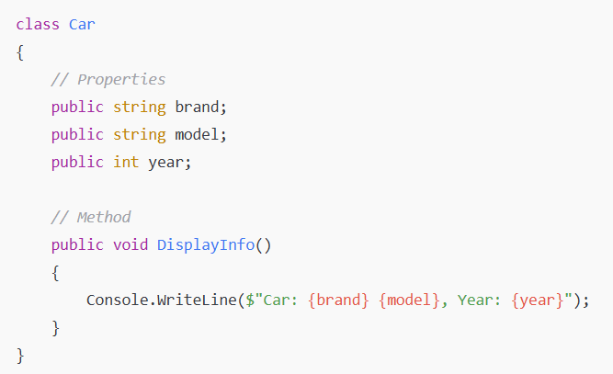
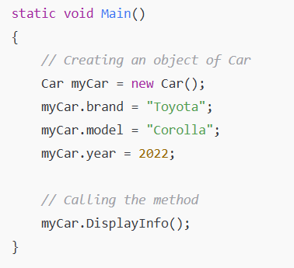
Purpose:
Classes help in organizing code.
Objects allow data and methods to be encapsulated together.

Slide 4
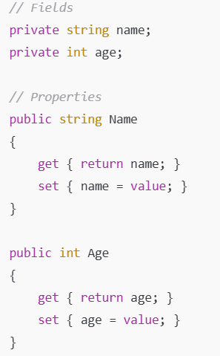
Key Components of a Class in C#
A class consists of:
Fields (Instance Variables) - Data members that hold values.
Methods - Functions that define the behavior of the class.
Properties - Encapsulation of fields using get and set.
Constructors - Special methods to initialize objects.
Destructors - Clean up when an object is deleted.

Slide 5
Access Modifiers in C# Classes
Access modifiers control the visibility/accessibility of class members.
Modifier | Scope
public | Accessible anywhere
private | Accessible only within the class
protected | Accessible in the class and derived classes

Slide 6
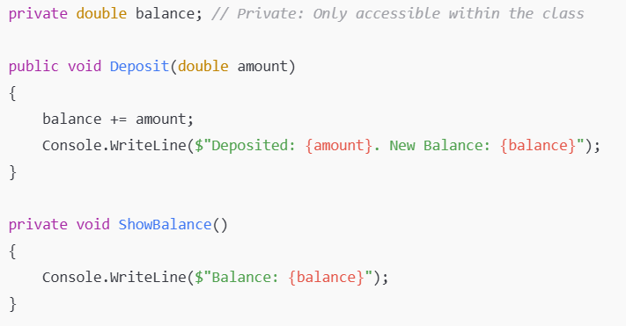

Slide 7
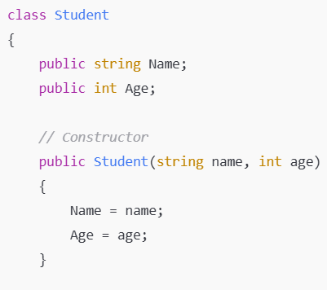
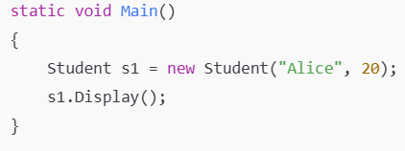
Constructors and Destructors in C#
Special methods with the same name as the class.
Used for initializing objects.
Types of Constructors:
Default Constructor
Parameterized Constructor
Copy Constructor

Slide 8
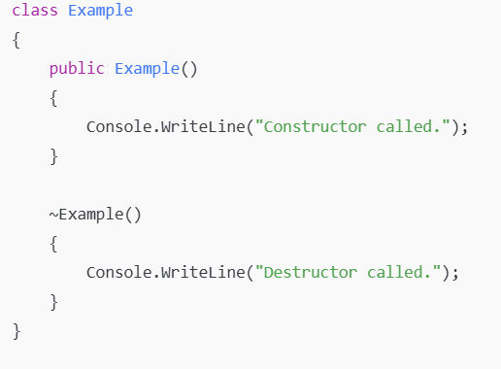
A destructor cleans up resources before the object is deleted.
Defined using ~ClassName().
Used for resource management.

Slide 9
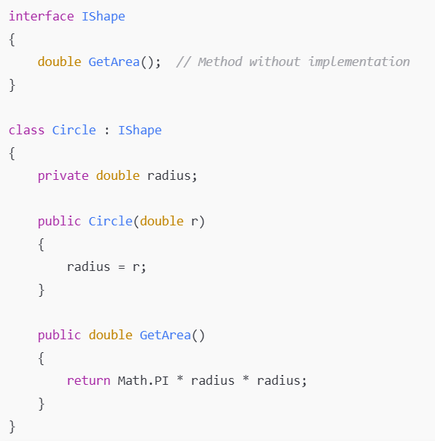
What is an Interface?
An interface in C#:
Defines a contract (set of methods and properties) that implementing classes must follow.
Does not contain implementations

Slide 10
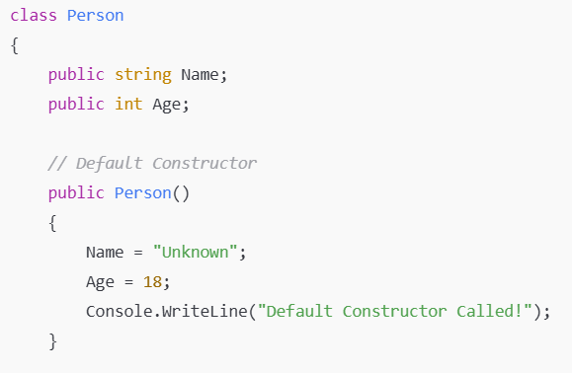
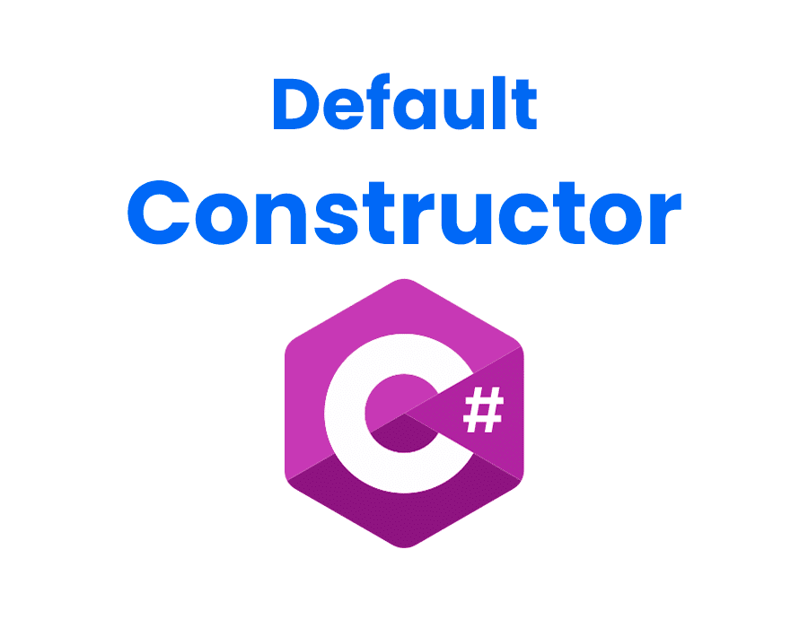
Types of Constructors in C#
1. Default Constructor
A default constructor is a constructor that does not take any parameters. It initializes an object with default values.

Slide 11
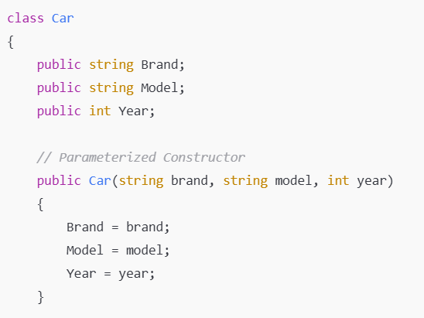
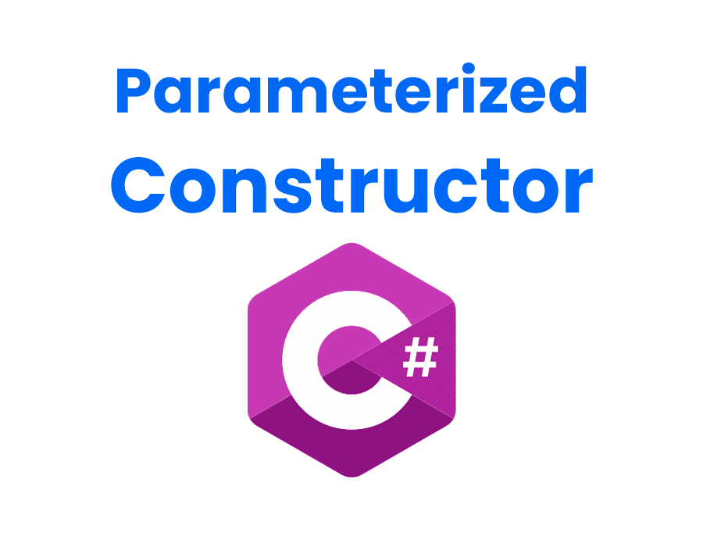
2. Parameterized Constructor
A parameterized constructor takes arguments to initialize an object with specific values.

Slide 12
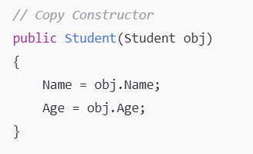

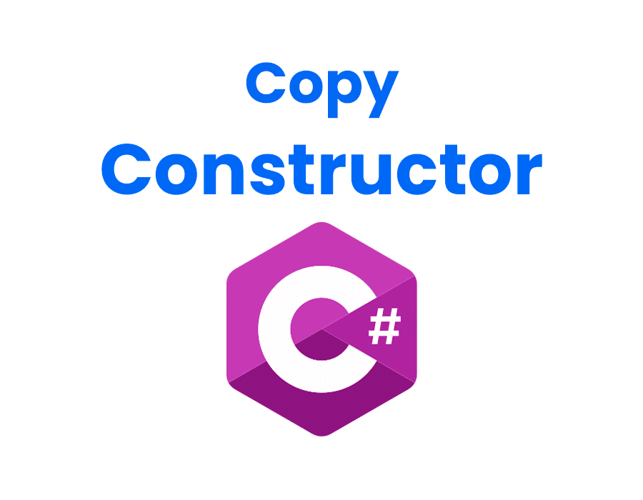
3. Copy Constructor
A copy constructor creates a new object by copying an existing object’s values.
Key Points:
Used to copy an object's data to a new object.
Useful when duplicating objects.

Slide 13
Class Task : Number Guessing Game (while loop)
Objective: Implement a simple guessing game using a while loop.
Instructions:
Generate a random number between 1 and 50.
Ask the user to guess the number.
Use a while loop to keep prompting the user until they guess correctly.
Provide hints (Too high! or Too low!).
Random random = new Random();
int targetNumber = random.Next(1, 51); // Generates a random number between 1 and 50

Slide 14
Class Task : Count Vowels in a String (foreach loop)
Objective: Count the number of vowels in a string.
Instructions:
Ask the user for a string.
Use a foreach loop to check each character.
Count and print the number of vowels (a, e, i, o, u).

Slide 15
Class Task: Check if a Number is Prime
Objective: Determine if a number is prime using a loop.
Instructions:
Ask the user for a number.
Use a for loop to check divisibility.
Print whether the number is prime or not.

Slide 16
Class Task: Find Row Sum in a 2D Array
Objective: Calculate the sum of each row in a 2D array.
Instructions:
Define a 3x3 matrix.
Use nested loops to sum each row separately.
Print row-wise sums.

